Slide 1
The Truth: SUGAR ADDICTION - 8 Times More Addictive Than Cocaine! -PURE WHITE and DEADLY
Pinal Doshi MD

Slide 2
QUIZ
-ADKINS DIET
MEDERRANEAN DIET
-Japanese Diet
What do all diets have in Common

Slide 3
Ideal Diet
Low sugar
High fiber

Slide 4
Defining Obesity/BMI
Obesity = excessively high amount of body fat or adipose tissue in relation to lean tissue, with Body Mass Index (BMI) greater than 30
Overweight = BMI>25 to 30
Normal weight = BMI between 18 and 24

Slide 5
International Data
Global Problem (2005)
1.6 billion adults overweight (age 15+)
400 million adults obese
20 million children under age 5 overweight
Current Trends – by 2020
2.3 billion adults overweight
700 million - obese

Slide 6
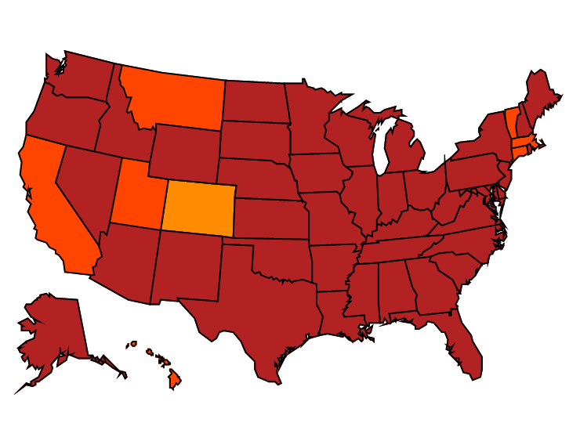
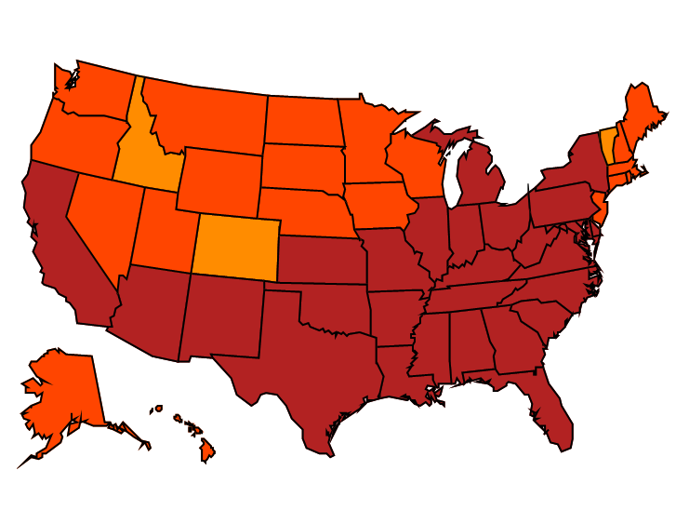
Age-adjusted Prevalence of Obesity and Diagnosed Diabetes Among US Adults
Obesity (BMI ≥30 kg/m²)
1994
2000
2014
No Data <14.0% 14.0%–17.9% 18.0%–21.9% 22.0%–25.9% > 26.0%
Diabetes
1994
2000
2014
No Data <4.5% 4.5%–5.9% 6.0%–7.4% 7.5%–8.9% >9.0%
CDC’s Division of Diabetes Translation. United States Surveillance System available at http://www.cdc.gov/diabetes/data

Slide 7
Growing Problem
Since 1960’s prevalence of obesity among adults has more than doubled [from 13.5 to 35.7%)
Obesity prevalence mostly stable from 1999 to 2010:
Slight increases among MEN (overall); black women and Mexican American women
Among children and adolescents, the prevalence of obesity increased in the 1980’s and 1990’s but mostly stable at 17%
From NIDDK, Overweight and Obesity Statistics, 2012)

Slide 8
US Data: National Institute of Diabetes, Digestive & Kidney Diseases (NIDDK)
Fast Facts
More than 2 in 3 adults overweight or obese
More than 1 in 3 adults obese
More than 1 in 20 adults – extremely obese
About 1/3 of children adolescents (6-19) are overweight or obese
More than 1 in 6 children considered obese
From National Health and Nutrition Examination Survey (2009-2010)

Slide 9
BIOCHEMISTRY AND BEHAVIOR
Insulin levels 3 times higher than before in the last 20 yrs
Calorie matters where it comes from
Processed food
Low fiber
High fructose corn syrup
Increased salt

Slide 10
CALORIES
We are eating 300 calories more than what we did 20 yrs ago
Majority Calorie intake is from Carbohydrates

Slide 11
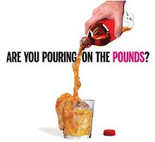
The Effects…
Soft drinks are the food category most strongly linked to increased risk of obesity and diabetes.
Vartanian LR, Schwartz MB, Brownell KD. Effects of soft drink consumption on nutrition and health: a systematic review and meta-analysis. Am J Public Health. 2007 Apr;97(4):667-75. Epub 2007 Feb 28.
Notes:
A systematic review of more than 88 studies found clear associations of soft drink intake with increased energy intake and body weight.
Soft drink intake also was associated with lower intakes of milk, calcium, and other nutrients and with an increased risk of several medical problems (e.g., diabetes).
Other Findings:
Study design significantly influenced results: larger effect sizes were observed in studies with stronger methods (longitudinal and experimental vs cross-sectional studies). Several other factors also moderated effect sizes (e.g., gender, age, beverage type).
Finally, studies funded by the food industry reported significantly smaller effects than did non-industry-funded studies.
Recommendations to reduce population soft drink consumption are strongly supported by the available science.
Vartanian LR, Schwartz MB, Brownell KD. Effects of soft drink consumption on nutrition and health: a systematic review and meta-analysis. Am J Public Health. 2007 Apr;97(4):667-75. Epub 2007 Feb 28.

Slide 12
The Effects…
For adults….
Drinking one or two sugary drinks each day increases the risk of developing type 2 diabetes by 25%.
Malik VS, et al. Sugar-Sweetened Beverages and Risk of Metabolic Syndrome and Type 2Diabetes. Diabetes Care. 2010; 33:2477–2483
Notes:
So what effect does all this sugar have?
Review slide….

Slide 13
SUGAR
Toxic calories
ADDICTIVE
Converts to fatty organ
According to CDC daily reqd 6-9tsf sugar we consume 24 tsf

Slide 14
Health Risks with Obesity
TYPE 2 DIABETES
HEART DISEASE
HIGH BLOOD PRESSURE
NONALCOHOLIC FATTY LIVER DISEASE
OSTEOARTHRITIS
SOME CANCERS (BREAST, COLON, ENDOMETRIAL, KIDNEY)
STROKE

Slide 15
Apple vs. Pear * Belly Fat
People with abdominal obesity (the characteristic “apple” or pot belly shape, rather than those with “pear” shaped backsides or extra subcutaneous fat) tend to secrete more insulin after eating and have high basal insulin levels, ultimately leading to elevated blood glucose, triglycerides, elevated blood pressure, unfavorable cholesterol ratios, and a host of other issues

Slide 16
Consider Inflammation
Belly fat is more metabolically active…and drives inflammation, which in turn promotes diabetes, cardiovascular disease, dementia and aging –
visceral/[belly] fat kills you…
Studies of humans have demonstrated that sucrose consumption correlates with the degree of liver inflammation
Inflammation can be measured by C-reactive protein (CRP) test
Robert Lustig: Fat Chance: Beating the Odds Against Sugar, Processed Food, Obesity, and Disease.

Slide 17
Low Carb Fresh Food KEY
Farmer’s market and/or raise your own – even in small spaces you can grow some fresh vegetables and fruits

Slide 18
PURE WHITE and DEADLY
THANK YOU

